Slide 1
Rights and democracy: an antagonistic relationship in European migration policy? The power of the demos and the rights of the barbarians Giovanna Zincone Rights, Democracy and Migration – Challenges and Opportunities University of Geneva 25 – 27 June 2015 IMISCOE 12th Annual Conference nccr – On the move 1st Annual Conference
Notes:
Why this provocative title? Even if we are aware, to quote Vertovec, of the super-diversity of treatments reserved to different categories of aliens, and of the super-diversity of our democratic systems, yet, in the background, we still can detect a sort of structural matrix, which we may identify already in the Athenian democratic archetype, that embodies some recurrent attitudes of closure towards the foreigners, oi barbaroi, the barbarians.

Slide 2
My presentation at a glance...
The “Matrix”
Current challenges to the Matrix features across Europe
Tightening (and not just tightening) policies in recent years
Rising anti-immigrant opinions & parties
A special focus on Italy
Fragility of the ‘liberal’ counterweights
In need of fairer relations with the demos: a political answer
Notes:
I will start by singling out the features of the original democratic Matrix, as it is defined in the Athenian archetype, then I will recall some of the present security, cultural, and economic challenges to the Matrix, and their different strength in different European countries. I will recall some consequences of the challenges on migration policies and immigrant rights, but on the other hand I will also notice the resistance of some rights. To explain this relative resistance I will propose a scheme which summarizes the classical liberal counterweights to demos will. As suggested by Gianni D’Amato, I will devote more attention to the Italian case. I will conclude by underlining the fragility of mere non political counterweights.

Slide 3
Pericles’ oration. The democratic Matrix & its closures
Cultural and security
critical points
Cultural and institutional pride
Fear of attack by disloyal insiders backed by foreign undemocratic powers
Fear of barbaric inflows
State of war
Junction
Legal formalisation of citizenship (451 – 450 B.C.)
Economic and fiscal critical points
Proto-welfare protection: risks of overstretching
Notes:
To identify the Matrix features, we may refer to the famous Funeral Oration of Pericles, as reported by Thucydides, which represents the quintessence of the Athenian myth and an archetype of the democratic matrix. It is also a starting point to identify some of the factors that, in a democratic perspective, may identify the risks aliens pose, and consequently of the reasons for their exclusion. I quote just few telling lines of the Oration.
“Our constitution does not copy the laws of neighbouring states; we are rather a model to others than imitators ourselves.
Its administration favours the many instead of the few; this is why it is called a democracy”
“Nobody need to be ashamed to admit poverty, but it is shameful not to do one's best to escape from poverty.”
“There is no exclusiveness in our public life, and in our private business, we are not suspicious of one another, nor angry with our neighbour/ if he does what he likes; we do not put on sour looks at him which, though harmless, his behaviours are not pleasant”.
“In short - Pericles continues - I assert that the city of Athens, taken all together, is a model for all Greece”
What really characterizes this self-portrait of the polis is the idea of the superiority of its cultural values, which include tolerance, and the belief of the superiority of its political institutions. This political and cultural pride implies a certain diffused contempt towards foreigners because of their backward attitudes and behaviours.
In the ancient Greek language the word for alien was βάρβαροi (from the onomatopoeic bar-bar, stutterer).
Other relevant reason of suspicion towards the aliens were grounded fears of disloyal insiders, the risk that domestic subversive groups could ally themselves with foreign undemocratic powers, ready to attack the country and overthrow democratic institutions.
Pericles was also the one who introduced the first nationality law in Europe. It embodied the restrictive criteria of ‘dual ancestry’ i.e. being born by an Athenian father and an Athenian mother. The law aimed at both excluding non democratic outsiders and avoiding an over-stretching of the Athenian proto-welfare, whose main provision was the distribution of the surplus crop among the citizens. Till then it was taken for granted that citizens were those people born and resident in the country who were neither immigrants nor slaves. Let us move to the current challenges to the matrix

Slide 4
The current Matrix under stress
Cultural and security
challenges
Cultural pride: the “barbarians” are backward and intolerant in the public and private spheres
Fear of disloyalty: they are the breeding ground for terrorism, in our current state of asymmetrical war
Fear of unauthorized inflows “invasion”
Junction
Impact on immigrant rights and access policies
Economic and fiscal challenges
Fiscal and financial crisis plus EU and domestic constitutional constraints on public expenditure, breeding the fear of competition on welfare
Slow or no economic growth & unemployment fear of competition on work
Notes:
Though many threats to democracy have historically come from within, I focus here only on threats perceived as coming from groups of alien origin, because these can possibly influence the attitudes of the demos towards immigration, and produce anti-immigrant measures. The presence in our societies of religious minorities of immigrant origins, difficult to integrate in a democratic sphere, is felt as a problem also by progressive political theorists. As John Rawls illustrated in “Political Liberalism” (1993) liberal-democratic states live out of pluralism. They are supposed to be hospitable also towards communities that have strong “comprehensive” creeds, provided that they accept the needed overlapping consensus on “constitutional essentials”. Unfortunately democracies – as Rawls notices – host also “comprehensive unreasonable groups”, which want their creed imposed in the public arena. Rawls is referring to Muslim minorities in particular. On this point, the Athenian notion of a cultural superiority of democracies vis-à-vis backward aliens may be seen as still playing a role in shaping public opinions. “Comprehensive groups” (some immigrant cultural minorities) can be considered as characterized by retrograde gender and parenthood relations, by inadequate familiarity with democratic and secularized values, in particular as regards religious pluralism. They can thus be framed as a disturbing element in democratic cohesion.
This sort of general cultural contempt can be accompanied by more specific fears. I am referring to the fear of domestic disloyalty, to the fear of terrorism of Islamic imprint, which does not seem strongly enough condemned and isolated by immigrant or converted coreligionists. The long series of dramatic terrorist attacks which had in Charlie Hebdo, in Bardo Museum, in Souss and Lyon – the last shocking episodes - are obviously having a strong impact on public opinion.
The asymmetric, transnational war led by Islamist groups such as al-Qaeda or the Islamic State may trigger another factor inherent to the matrix, the fear of aliens as fifth-columns of foreign powers.
Although not scientifically reliable, a recent Al Jazirah survey that showed an 80% support to Islamist groups was quite shocking.
The dramatic increase of mixed inflows perceived as a sort of “barbarian invasion” is reinforcing not just cultural and security, but also economic concerns.
If we move to focus on some economic challenges, we can notice that they can impact even more strongly than security concerns on immigrant rights.
I limit myself to mentioning just two main points:
FIRST, the presence, or the future risk, of major fiscal crises is already well perceived by all OECD governments, and these governments have mostly adopted self-imposed constitutional constraints or accepted binding rules decided by international bodies; in particular, the EU did so through the 2012 Fiscal Compact. Consequent spending constraints implied a reshaping of welfare provisions, mainly of pensions and public health, and have fostered measures aimed at managing the access to labour markets by foreigners, in order to maximize the prospective of public revenues and minimize the risk of future fiscal burdens.
SECOND, the economic crisis which hit (though to a different extent) our economies and increased unemployment rates in many EU countries (which had often a special impact on immigrant workers) increased concerns about immigrants welfare burden and domestic low skilled workers displacement.
Let us give a look to some data on the dimension of the quoted challenges

Slide 5
Challenge 1(a): “Invasion” Unauthorized flows at EU's external borders 2011-14
Detection of illegal border crossing between border crossing points (2011-2014)
Source: Frontex, Annual Risks Analysis, 2015
Notes:
The unauthorized inflows had increased dramatically at the EU external borders in the last years. We are all aware that certainly the Europe is not the most affected region by this phenomenon, however the perception of this issue, also because of its mediatization, has a remarkable impact on public opinion, on electoral behaviours and election outcomes
Part of the so-called mixed inflows resulted in important growth rates of asylum seekers in some countries (e.g. Hungary and Italy, but also Germany and Sweden).

Slide 6
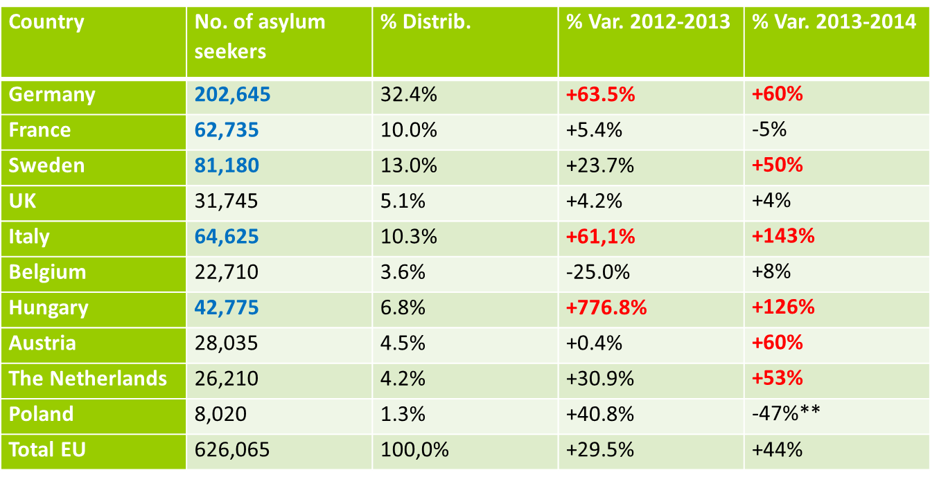
Challenge 1(b): “Burden and invasion” Asylum and refugees status applications
Top ten countries by number of asylum seekers, 2014
Source: Eurostat
Notes:
In fact, if we look at this table we can notice the rapidity of the growth which may play an even more important role in the public perceptions than absolute numbers.
These figures may help in explaining the attempted rejection of the Dublin Convention by Hungary and the recurrent dramatic situation at the French-Italian border.
Summing up the situation, unauthorized inflows and refugees flows, are producing extremely tense relations among the Union members and threatening two EU milestones, namely the Dublin Convention and Schengen Agreement.
Also unemployment can play a role in orienting voters’ behaviours and migration policies.

Slide 7
Challenge 2 (“Burden or Competitors”) Foreigner vs national unemployment (2014)
Source: Eurostat
Notes:
The rate of immigrant unemployment in general tends to appear ceteris paribus higher than that of nationals due to their higher rate of activity. However the gap between nationals and immigrants when it is relevant, as in some countries like Sweden, may produce anti immigrant attitudes and may suggest restrictive labour inflows policies. The perception of the gap should be different when also nationals’ levels of unemployment are so high as to monopolize public attention, as is the case in South European countries.
These and other challenges, some of them having already started before the more recent crises, have produced and are still producing reductions of immigrant rights and tightening of migration policies.

Slide 8
Tightening policies in recent years
Also as a consequence of the economic crisis a reduction in access to fundamental rights (EU Parliament report 2015)
Selective borders policies: favoring high skills, discouraging less productive segments, limiting their impact on welfare systems (also of EU migrants)
Sliding borders: “integration abroad”
Notes:
A recent report of the European Parliament surveyed a reduction of fundamental rights after the 2008 crisis which is affecting all weaker strata, not just immigrants, This conclusion is not comforting, because poor people competition on scarce resources can be a supplementary source of inter-ethnic conflicts as many researches at local level had already shown.
I do not want to recall the long list of measures adopted to discourage unskilled inflows and to limit immigrant access to welfare, the shifting boundaries. The increasing concerns and measures regarding the mobility and rights even of EU citizens were and are object of too many analysis and researches.
What we may consider more interesting as social scientists is not so much this restrictive response, coherent with demos concerns, but the relative resistance of migration and migrants rights.
Two foreseeable consequences of the economic and cultural challenges should have been: 1) drastically reduced inflows, in particular of labour migration, and 2) deeply undermined multicultural measures.

Slide 9
All that notwithstanding ….
Rights-based migration flows still continue, and in most EU countries they are still producing positive net migration
Also managed labour migration flows have continued under different forms, allowing also non high skilled migrants
Multiculturalism is still resisting & nationality laws have not been uniformly tightened in the EU
Notes:
In fact these hypotheses are partially disproved. We all know that inflows did not stop, often producing (though not in all European countries) still positive net balance. This was mainly due to family reunion and asylum; these rights in fact were smoothed but were not (at least so far) drastically restricted. The action of national and European courts, which are usually particularly sensitive on this matter, proved to be quite effective. On the other hand, I would like to focus on a legal concept: the difference between prescriptive and indicative rights. Asylum is becoming more and more an abstract right as far as refugees are not admitted into the EU borders.
As labour migration is concerned, I would like to mention an empirical research, carried out in 6 EU countries, directed by Pastore (2014), which demonstrates that “Under the frozen surface of alleged ‘zero (labour) migration’ doctrines, linkages between population movements and labour dynamics were persistent and still strong. Migrant labour supply policies find different ‘paths of least resistance’ to satisfy labour demand without alarming public opinion. While all Governments pretend to give priority to the less alarming high skilled workers, and in fact they do, however they also accept unskilled workers as in Sweden by devolving responsibility to the employers (i.e. to the market), or in Germany by stretching the high skilled criteria by administrative devices, or in the UK where even if reluctantly, EU mobility provides also low skilled, or high skilled - de facto - working in low skilled jobs.
As Salis noticed, the Italian “least resistance path” is offered by the care-givers, needed by families and quite popular in the Italian imagery. So, under this harmless category of immigrants, also other kind of low skilled workers were included in planned inflows or regularized a posteriori.
In a globalized competitive economy, multiculturalism is becoming also an asset, as Kymlicka (2013) “Neoliberal multiculturalism” perspective suggests.
The EU Commission as well, in a 2013 document, shares this perspective, and underlines the positive aspect of Diversity management. When it comes to Nationality laws in Europe, Bauböck, Vink & Dumbrava (2014), having taken into consideration a consistent set of variables, has reached the conclusion that there is not a uniform restrictive trend. And we may consider nationality laws as the most symbolic of the immigrants’ rights.
And even restrictive measures, such as civic integration contracts, courses and tests, do not produce necessarily only restrictive results.
These measures can be considered a sort of European combined answer to both cultural and economic challenges, since they were openly aimed to foster both cultural and economic integration, and indirectly to discourage unwanted inflows. In fact their capacity to reach these aims is still under scrutiny. (Scholten et alii 2012; Lechner et alii 2012)
On the other hand, surprisingly, civic integration courses were often positively judged by their participants as, for instance, Caponio reported in the Prosint project. Rights and duties are not always antagonists: the legal concept of right-duty demonstrates that they can be coupled. For instance in all modern democracies children education is a right (for the children) and a duty (for the parents).
Stuart Mill in Considerations on Representative Government affirms implicitly a similar concept, when he maintains that is reasonable not to enfranchise incompetent people, but at the same time he considers a strict duty of liberal regimes to enable power ignorant people to become competent. To reach this fundamental aim, according to Stuart Mill, educational opportunities are the main tool, and they should be costs free or at least affordable by poor people. While the Dutch civic education model contradicts Mill, being a too heavy burden on immigrants shoulders, the Italian case contradicts Mill’s recipe for the opposite reason, being super light and completely ineffective: a paper right as well as a paper duty; in fact, it makes compulsory only a ten hours civic education course and requires a very low-standard poorly checked language test. The Italian case highlights not only the inconsistent and superficial nature of supposed policy transfers, but also the complexity of the decision making reactions in face of the mentioned challenges.
Let us now move to briefly treat the Italian case

Slide 10
The Italian case From anti-immigrant parties to anti-immigrant policies?
Anti immigrant parties in power
Courts & civil society & EU suasion undermined Bossi-Fini Law (2002) & Security Package (2009)
Civil society & Market (inflows, amnesties)
Pragmatic problem solving (mass regularizations)
Notes:
Italy experienced a long political phase, in which – even if not without interruptions – a center-right majority ruled the country. That winning coalition included xenophobic components. And yet, even under these circumstances, the policies were less coherently restrictive than we might have expected. The action of the courts was able to nullify many anti-immigrant measures in particular those aimed at undermining health and educational rights of the undocumented migrants.
The organized civil society played a crucial role as well. Even though, during the electoral campaigns, according to Edelman thesis, politicians’ rhetoric is addressed to the electorate, when in government/ even center-rights parties should take into consideration the interests of lobbies. And, as I have already written in several works, Italian pro-immigrant benevolent lobbies are particularly strong, and in alliance with the employers, they were able to obtain frequent mass regularizations.
Pragmatic problem solving can also explain recurrent huge regularizations, even under centre-right governments. In a context of financial difficulty, mass regularizations are also devices to cash administrative fees right now, and raise public revenues in future by receiving more taxes & contributions.
The Italian case offers also the opportunity to explain an interesting aspect of electoral behavior: not always strong anti-immigrant opinions do translate into anti-immigrant votes.

Slide 11
Immigration from outside EU does evoke a positive or a negative feeling?
Source: Eurobarometer, Autumn 2014
Notes:
The strong anti-immigrant attitudes of the Italian electorate in 2014 are absolutely clear from this Eurobarometer 2014 survey – but there are many other surveys telling the same story
It is thus quite surprising that, in the 2014 European Elections, such strong anti-immigrant opinions were not able to translate into Rightist parties’ victories.

Slide 12
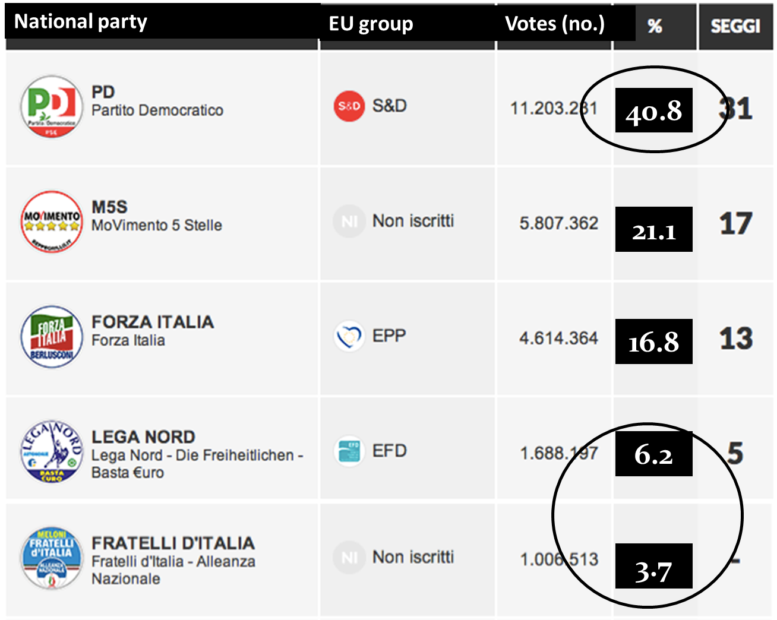
The Italian case (1a) - From anti-immigrant PO to anti-immigrant winning coalition?
Notes:
On the contrary these elections rewarded, as never before in Italy, a centre-left party. We may find a first explanation in the fact that radical anti-immigrant parties run divided and they were not allied with their traditional partner, the Berlusconi’s party. Furthermore, in the EU elections, while the proportional system encouraged fragmentation, the representation (4%) threshold penalized small radical right-wing parties. However, parties alliances and electoral systems can explain the unfavourable translation from xenophobic votes into sets, but not the huge movement of the votes towards the Democratic Party.
While, as historians and social scientists we focus on individuals, when studying transition to democracy, we tend to under evaluate their role in established democratic system functioning. To me, another explanation of the striking nature of the centre-left victory can be found in the ability of its leader Matteo Renzi to create a narrative, amplified by the media, which distinguished himself from the incumbent majority, casting himself in the role of wrecker of the leftist traditional elite. Another under evaluated variable is the relative positioning, i.e. the hierarchy of public concerns.

Slide 13
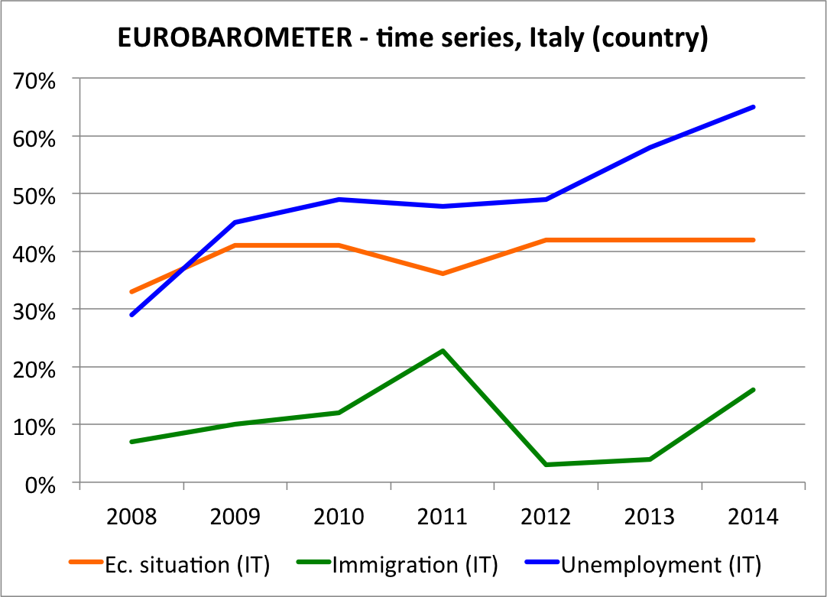
The Italian case (1b) From anti-immigrant PO to anti-immigrant winning coalition?
Hierarchy of public opinion concerns
Notes:
Due to the general context of economic crisis. Unemployment fears and the need for an economic recovery were more salient than ever, and Renzi was able in focusing his electoral campaign on these issues. However, the center-left supremacy is now under pressure. As we can catch by looking at the last electoral results.

Slide 14
The big leap forwards The Lega Nord outside its traditional territorial settlement, Italian elections 2013-2015
Region | % 2013 Regional elections | % 2014 European elections | % 2015 Regional elections
Liguria | 2.3 | 5.6 | 20.2
Tuscany | 1.1 | 2.6 | 16.2
Umbria | 0.6 | 2.5 | 14.0
Marche | 0.7 | 2.7 | 13.0
Emilia Romagna | 2.6* | 5.0 | 19.4
* Regional election 2014
Source: Ministero Interno
Notes:
The results of the 2015 partial regional and local elections registered a big leap forwards of the Lega Nord. The League has casted aside its traditional themes of devolution and even secession in favor of a strongly xenophobic focus. It was already in power in Lombardy, a region which did not vote this time, as well as in Veneto, where its power was clearly confirmed. But what surprised and scared the Renzi’s PD majority was the League dramatic electoral success outside its traditional heartland, into Northern and Central Italian regions once dominated by leftist parties. Again part of these results can by explained by the fact that the right parties were allied when needed, while the center-left in some city run divided after having split, and also the still formally united PD showed deep internal cleavages which troubled the electorate, and produced other defections and splits after the elections . Again the role of individuals proved fundamental. The young Northern League leader Matteo Salvini, was capable to vocally invade any king of new and old media. He was also able to couple the immigration issue with anti EU stances. Blaming EU for impairing the Italian Economic economic recovery because of a coercive austerity and the consequences on Italian export of the sanctions imposed to Russia. Paradoxically the relative success of the Renzi government in improving the economic situation, often was not perceived, and when perceived left space to other issues. Immigration became the main character of the play, because of the increase in unauthorized inflows in Italy and the media dramatization, where the notion of an “invasion” was repeatedly used. And in fact the unauthorized inflows increase was there.

Slide 15
The “invasion” panic: mixed flows arrivals in Italy
Source: Ministry of Interior, Frontex for 2014
Source: OIM
Notes:
Furthermore, Renzi’s pro Europe culture became a disadvantage, due the scarce solidarity of the European partners in managing the impact of mixed flows. By contrast anti-EU attitudes were an asset of his main competitors. On the other hand, it must be taken into account that also leftist voters are not immune from anti-immigrant attitudes and they are consequently exposed to anti-immigrant parties attraction.

Slide 16
Anti-immigrant opinions in Italy: the left electorate
% “Immigrants are a burden: they take jobs & social benefits”
All 69% Left 53%
% Unfavourable views of Muslims
All 63% Left 50%
Source: Pew Research Center, May 2014
Notes:
This recent (2014) Pew Research survey can contribute in further explaining the Northern League success, showing clear anti-immigrant attitudes present also in the center-left electorate

Slide 17
Growth of anti-immigrant parties in some European countries European elections (2009 and 2014)
Country | Main anti-immigration party | % 2014 | % 2009
Finland | PS (True Finns) | 12.9 | --
Denmark | Dansk Folkeparti | 26.6 | 14.8
Sweden | Sverigedemokraterna | 9.7 | 3.3
UK | UKIP | 26.7 | 16.1
Italy | Lega Nord/Fr.d’It. | 6.1/3.7 | 10.2/0.8
France | Front National | 24.9 | 6.3
Hungary | Jobbik | 14.7 | 14.7
Austria | FPOe | 19.7 | 12.7
Netherlands | PVV | 13.3 | 16.7
Source: European Parliament
Notes:
Obviously the growth of anti-immigrant parties is not just and not mainly an Italian problem. For the sake of simplicity I used a comparison between the two last EU elections. It should be noted that following national or regional elections have confirmed or even reinforced the trend shown in these data. For instance in Sweden the SD party reached 13% in the September 2014 national elections; - in Finland the True Finns reached 17,7% in the 2015 general elections, and so on.
Even more importantly, we are witnessing a move towards anti-immigrant positions in the political agenda of traditional center-right parties (Cameron and Sarkozy are a telling example).

Slide 18
Potential liberal counterweights
CONSTITUTIONAL RIGHTS AND COURTS
INTERNATIONAL CHARTS AND COURTS
MARKET FORCES
ORGANIZED CIVIL SOCIETY AND ADVOCACY
Notes:
In this changing political scenario, can we still rely on what we could define as “liberal” counterweights to the demos will?
They have undoubtedly played an important role, as we have seen in the Italian case, but also on the larger European scale. However, I suggest to define them just as potential counterweights, because they have not always acted as protectors of immigrant rights. Many pro-immigrant, but also some adverse rulings of Constitutional or Supreme courts are reported in the book I edited with Rinus Penninx and Maren Borkert. Let me just recall some examples of adverse rulings. The rejection of European Parliament’s appeal to the Court of Justice against restrictions for minor children family reunions (June 2006), the German Supreme Court which excluded the possibility for married women to keep their nationality in 1953, though it upheld its decision in 1999. From the 1990s onwards, the same court no longer opposed government policies aimed at reducing asylum inflows and the costs involved (Borkert & Bosswick ibidem). Also the 2013 Greek Council of the State decision against the 2010 ius soli reform can be considered another example of the relative fragility of our counterweights.
Market forces have their own reasons, not always overlapping with more openness in migration policies.
The capacity of organized pro-immigrant civil society to influence the decisions making is not always bound to find windows of opportunities in Governments which include strong xenophobic parties.

Slide 19
Take the demos seriously: a moral and political obligation
In my country and in other self-styled democracies, can we just rely upon liberal counter-weights to the majority will?
Is this not a fragile and quite unfair remedy?
And, above all, will it last?
Notes:
We should put these serious questions to ourselves as scholars and even more as European citizens.
The domestic barbarians – in fact a large part of our demos, more often vilified than understood – are just a threat to be kept under control with the mentioned ‘liberal’ counterweights?
Are not in need of political counterweights, that will work within democracy, not outside it?
I would dare to say that we probably need well rooted constructive populisms to counterweight the destructive ones.

